Slide 1
Improving Career Prospects & Workforce Productivity!
AGILE MASTERS INC.
WWW.AGILEMASTERS.ORG

Slide 2
AGILE MASTERS is simply an online & in-person professional training platform that empowers individuals, teams, and organizations with Agile expertise to deliver transformative solutions, support organizational agility, enhance individual productivity, and drive industry growth.
Explore the power of AGILITY
and take advantage of the Agile Masters Online Opportunities with diverse professionals!
WWW.AGILEMASTERS.ORG
…adding value to individuals & organizations!
2

Slide 3
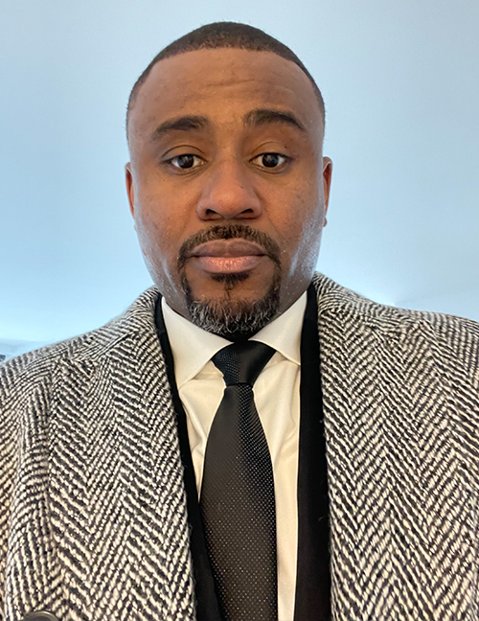
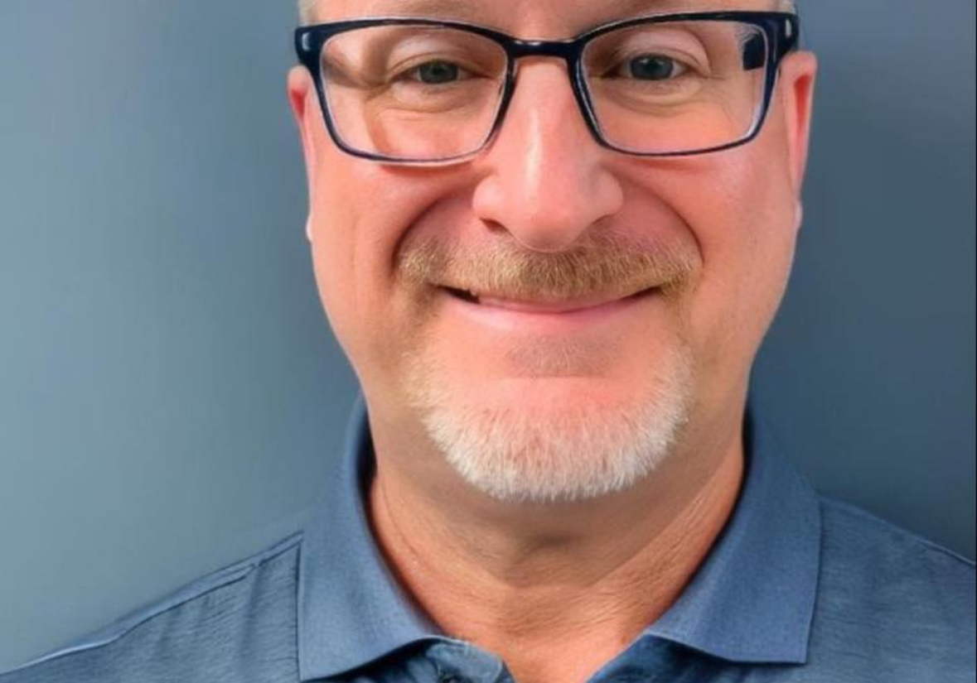
MEET OUR TEAM
Festus a. otabor
Administrator
Beluchi brown
JerEmiah agboiyi
Organization Agility Coach
Agile Transformation Coach
Gary montgomery
Team Support Coach
Visit:
www.agilemasters.org/instructors for more details.
3
Notes:
Note: Insert your picture by clicking on the Picture Place Holder Icon, then send it back!

Slide 4
ACCREDITATION PARTNERS
AGILE MASTERS currently Partners with two major Agile
Globally Accredited Licensing institutes i.e.,
# SCRUMstudy™-VMEdu® which has:
- 2100+ Partners with Employees from 3500+ Companies.
- Certified Over 1,000,000 Professionals in 150+ Countries.
- 7,500+ SCRUMstudy™-VMEdu® Certified Students Monthly
[More than any other Certification Body - as seen on the graph]
# SCALED AGILE INC. - SAFe® [Scaled Agile Framework]:
- The world’s most Trusted System for Business Agility.
- Adopted by more than 20,000 Enterprises Globally.
- Over 1,000,000 Practitioners Trained.
- Supported by more than 500 World-class Transformation
& Platform Corporations in 110+ countries.
[AGILE MASTERS remains ONLY Partner with Robust System
that practically manages its student’ continuous learning - ]
WWW.AGILEMASTERS.ORG
4
Notes:
Note: Insert your picture by clicking on the Picture Place Holder Icon, then send it back!

Slide 5
AGILE MASTERS
REQUEST SUMMARY
WWW.AGILEMASTERS.ORG
The AGILE Masters Training and Certification Program is set to equip major Public & Private Workforce | Executive Leaders with related Agile skills to effectively lead and manage diverse industry sector going forward.
To support the Global Agile Transformation Drive, we request that Your Office endorses the Agile Masters Training & Certification Program for its respective Public Officers —covering the SAFe for Government Certified Course. This drive is designed to leverage on some established regional subsidy to considerably cut down on the financial cost implication.
Affixed cost of the training
per official is $1,950.00 and
Agile Masters offers a regional subsidy waiver of 50% for All Public Officers. While your
office further secure payments
to cover the balance 50% toward getting the program available
for the respective Public Officers or have them pay the balance
of $975 for the SAFe for Government course, as deem fit.
5
Notes:
Note: Insert your picture by clicking on the Picture Place Holder Icon, then send it back!

Slide 6
Program structure
Training course modules
Accreditation process
SAFe For Government:
This consist a 4-session [3-hours each] Instructor-led live-class training with 1-hr Q&A per session | total of 4-hour follow-up | access to self-study material, exam scheduling, and certification upon passing exam.
This includes access to continuous learning support from instructors & other Agile Experts via the Agile Masters Discourse Platform.
[plus Applicable Coaching Support].
Affixed cost of the training per official is $1,950.00 and Agile Masters has secured a waiver of 50% for all your Public Officials.
Instructor-led Live Classes:
Attend the instructor-led live classes, and
receive initial Certificate of Participation
Covering 2-Continuing Education Unit.
Professional Self-study/Exam/Certification:
Gain access to the advance course materials
and exam scheduling for a more professional accreditation from the Agile Masters Accreditation Institute.
Continuous Professional Development:
Access Agile Masters 24/7 interactive live
coaching support platform for tackling daily challenges, increase productivity, lead effectively, and boost/improve workplace
confidence.
THE COST
[$1,950 LESS 50% WAIVER]
$975.00 ONLY!
6
WWW.AGILEMASTERS.ORG
Notes:
Note: Insert your picture by clicking on the Picture Place Holder Icon, then send it back!

Slide 7
BENEFITS TO the PUBLIC SERVICE?
1. Enhanced Project Delivery
• Efficiency: Trained officers streamline processes, reducing timelines and costs, leading to quicker service delivery.
• Resource Optimization: Officers better manage resources, ensuring effective use of public funds and personnel.
2. Strategic Alignment
• Consistent Vision: SAFe aligns projects with organizational goals, ensuring all efforts support the public service mission.
• Accountability: Transparent frameworks that enable better progress tracking & accountability.
3. Adaptability
• Policy Response: Officers quickly adapts to policy changes, keeping the organization agile.
• Flexibility: Projects gets adjusted to remain relevant and effective.
4. Improved Collaboration
• Cross-Departmental Collaboration: Agile-SAFe fosters communication across departments, breaking down silos.
• Stakeholder Engagement: Regular interaction ensures public services meet community needs.
5. Risk Management
• Risk Mitigation: Officers get equipped to identify and mitigate risks early, reducing project failures.
• Compliance: Agile-SAFe ensures adherence to laws and regulations, minimizing legal risks.
6. Continuous Improvement
• Learning Culture: The program encourages ongoing learning and application of lessons to future projects.
• Innovation: Agile-SAFe promotes experimentation and feedback, driving service innovation.
7. Employee Empowerment
• Job Satisfaction: Certified officers feel more confident, leading to higher job satisfaction.
• Empowerment: Training empowers officers to make informed decisions, enhancing organizational responsiveness.
In summary, the Agile-SAFe for Government program equips public service organizations with the tools to improve efficiency, adapt to changes, enhance collaboration, manage risks, and continuously innovate, leading to superior public service delivery.
WWW.AGILEMASTERS.ORG
Notes:
Note: Insert your picture by clicking on the Picture Place Holder Icon, then send it back!

Slide 8
BENEFITS TO the PUBLIC OFFICER?
1. Enhanced Skill Set
• Agile Expertise: Officers gain specialized Agile knowledge for managing complex projects in government.
• Versatility: The program equips officers with adaptable skills across various roles.
2. Career Advancement
• Professional Growth: The certification boosts competitiveness for promotions & leadership roles.
• Recognition: Certified officers are seen as Agile experts, enhancing their influence.
3. Increased Efficiency
• Project Management: Officers manage projects more efficiently, improving productivity.
• Resource Optimization: Officers learn to better allocate resources, maximizing efficiency.
4. Adaptability and Innovation
• Agility: Officers respond more effectively to policy changes and challenges.
• Innovation: The program encourages continuous improvement and new solutions.
5. Improved Collaboration
• Teamwork: Officers collaborate more
effectively across departments.
• Stakeholder Engagement: They ensure their work aligns with community needs.
6. Job Satisfaction
• Confidence: Officers feel more capable in
their roles.
• Empowerment: The training empowers officers to make informed decisions and drive change.
7. Risk Management
• Risk Handling: Officers proactively manage
risks, minimizing project impacts.
• Compliance: The program ensures adherence
to regulations, reducing risks.
In summary, the Agile-SAFe for Government program equips public service officers with the skills and confidence to manage projects effectively, advance their careers, collaborate better, and drive innovation, leading to a more fulfilling and impactful career in public service.
WWW.AGILEMASTERS.ORG
8
Notes:
Note: Insert your picture by clicking on the Picture Place Holder Icon, then send it back!

Slide 9
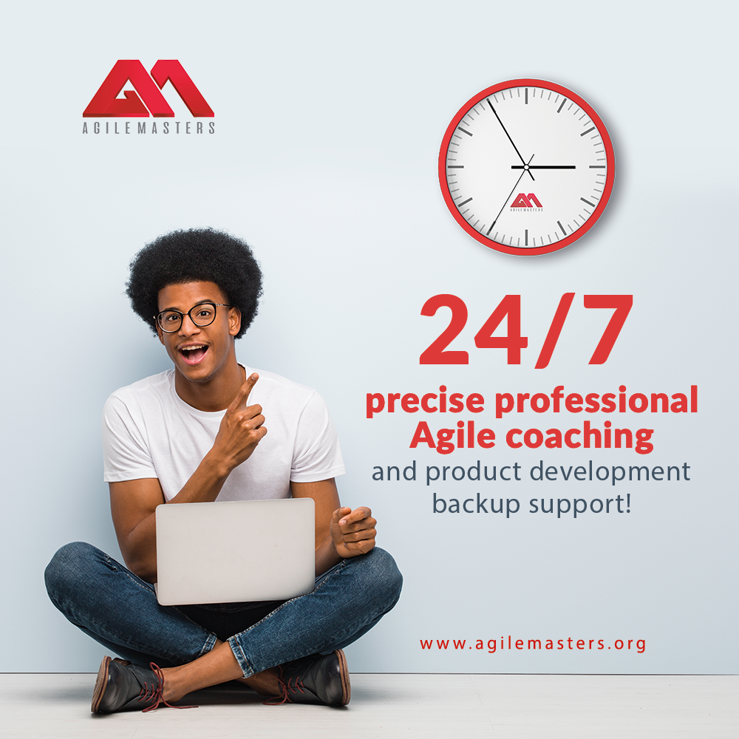
BENEFITS TO the country?
1. Improved Public Service Delivery
• Efficiency: Officers deliver services faster and more effectively.
• Resource Management: Optimized use of public funds ensures better taxpayer value.
2. Enhanced Government Responsiveness
• Agility: Officers adapt quickly to policy changes, enabling swift government responses.
• Crisis Management: Improved readiness for crises ensures decisive action.
3. Strengthened Governance & Accountability
• Transparency: SAFe promotes transparency, enhancing accountability and reducing corruption.
• Compliance: Adherence to regulations maintains public trust and the rule of law.
4. Economic Growth and Stability
• Efficiency: Accelerated government
projects stimulate economic growth.
• Innovation: The program drives
modernization and competitiveness.
5. Increased Citizen Satisfaction
• Improved Services: Citizens experience a more reliable and responsive services.
• Engagement: Better alignment with citizen
needs through stakeholder engagement.
6. National Security and Resilience
• Risk Management: Enhanced risk mitigation supports national security.
• Strategic Alignment: Projects align with
national priorities, strengthening the country.
In summary, the Agile-SAFe for Government program strengthens public service efficiency, responsiveness, governance, economic growth, citizen satisfaction, and national security, building a more resilient nation.
WWW.AGILEMASTERS.ORG
13
Notes:
Note: Insert your picture by clicking on the Picture Place Holder Icon, then send it back!

Slide 10
JOIN us
In this Agile Transformation Drive…
As We Get Every Corporate Workforce
AGILE SAVVY & Certified!
+1 [332] 249-7355 | +234 [916] 326-8690 agilemasters.org@gmail.com | www.agilemasters.org
Level 85 – One World Trade Center, New York – NY 10007
WWW.AGILEMASTERS.ORG
Notes:
Note: Insert your picture by clicking on the Picture Place Holder Icon, then send it back!

